Slide 1
Lecture 2
Functions
June 20, 2017
Expressions & Names
Environment Diagrams
Environments

Slide 2
Announcements
Set up your computer and accounts (Lab 0) by tonight
Office hours begin today!
Make sure that okpy.org shows your submission!
Discussion sections begin today!
Feel free to shop around but try to decide by next week
Quiz on today's material will be in Thursday discussion
One exam-level question, 10 minutes, multiple choice
Full credit for reasonable effort
Homework 0 (Survey) due Friday at 11:59 pm
Class potluck on Friday from 5-6:30 pm at Memorial Glade
Lab check-offs start next week

Slide 3
Expressions & Names

Slide 4
Expressions
Primitive expressions evaluate directly to values
2
add
'hello'
Numbers
Names
Strings
Call expressions follow the evaluation procedure
Evaluate the operator
Evaluate the operands
Apply operator to operands
1 * 2
mul(1, 2)
max ( 2 , 3 )
Operator
Operand
Operand
Apply!

Slide 5
Names
Demo
Giving names to values makes programming easier!
An assignment statement is one way to bind a name to a value
x = 1
Each name can only be bound to one value
Environments keep track of names and their values
Execution rule for assignment statements
Evaluate all expressions to the right of = from left to right
Bind all names to the left of = to those resulting values in the current environment frame

Slide 6
>>> f = min
>>> f = max
>>> g, h = min, max
>>> max = g
>>> max(f(2, g(h(1, 5), 3)), 4)
???
Notes:
Spend a minute or so thinking on your own and try to come up with an answer. 1, 2, 3, 4, 5, or not sure?

Slide 7
Environment Diagrams

Slide 8
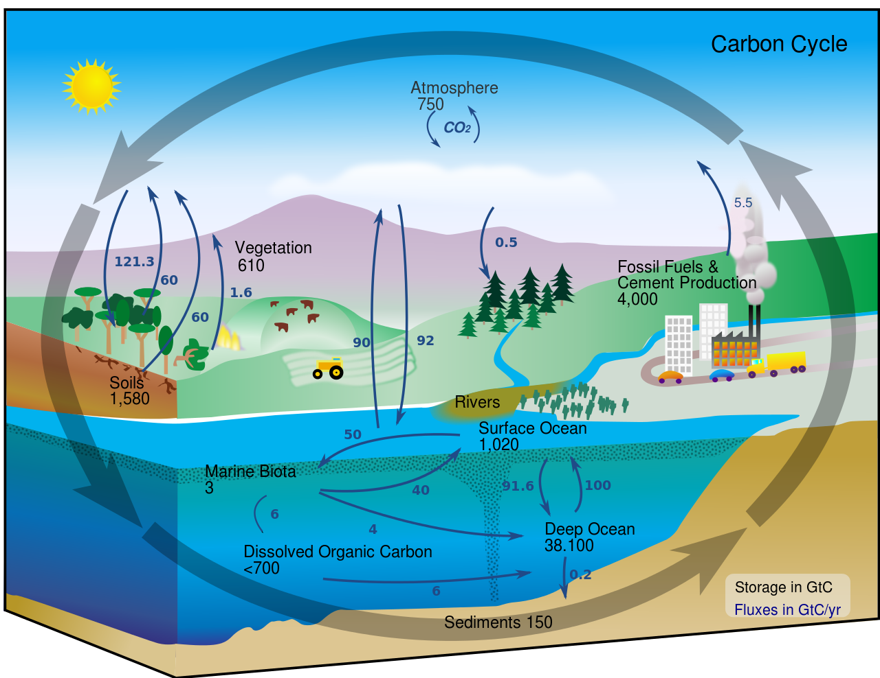
Sorry, NASA...

Slide 9
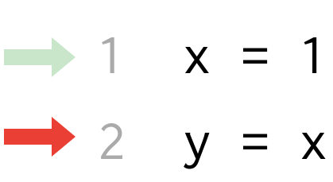
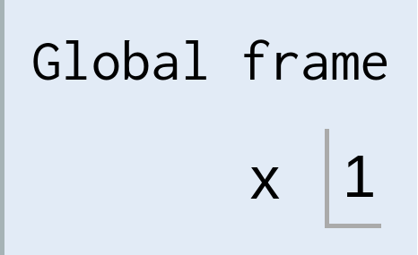
Environment diagrams
Demo
Environment diagrams visualize the interpreter's process
Just executed
Name
Value
Next to execute
Assignment statement
Binding
Code (left)
Statements and expressions
Arrows indicate evaluation order
Frames (right)
Each name is bound to a value
Names cannot be repeated in a frame

Slide 10
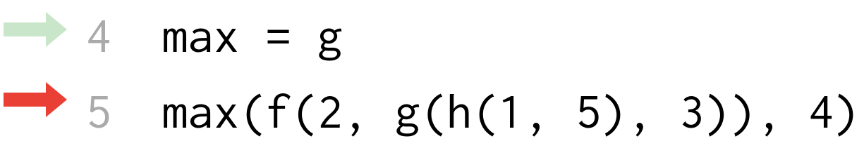
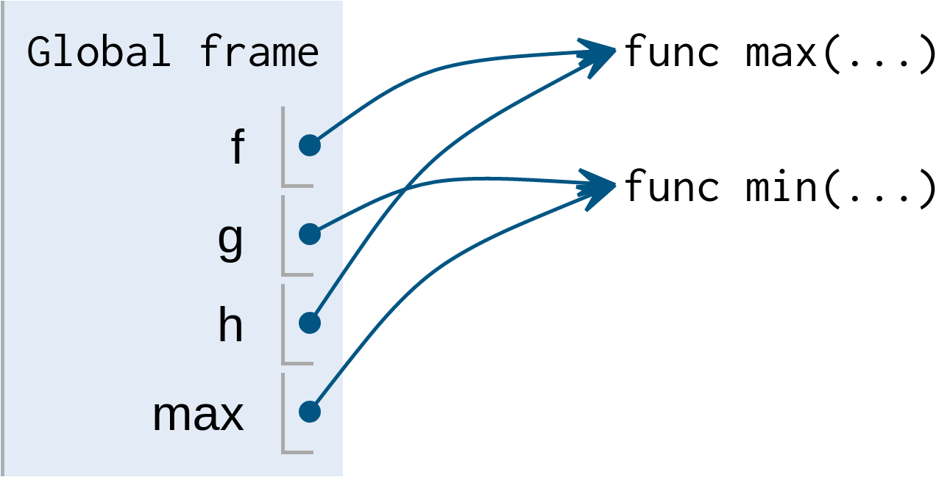
Let's see it in action!
Demo
3
Find the matching parenthesis!
func min(...)
3
4
f(2, g(h(1, 5), 3))
func max(...)
2
3
g(h(1, 5), 3)
3
func min(...)
5
3
h(1, 5)
func max(...)
1
5

Slide 11
Functions

Slide 12
Defining functions
Functions have inputs and outputs
Function signature indicates name and number of arguments
def <name>(<parameters>): return <return expression>
def square(x): return mul(x, x) y = square(-2)
Function body defines the computation
performed when the function is applied
Execution rule for def Statements
Create a function with signature <name>(<parameters>)
Set the body of that function to be everything indented after the first line
Bind <name> to that function in the current frame

Slide 13
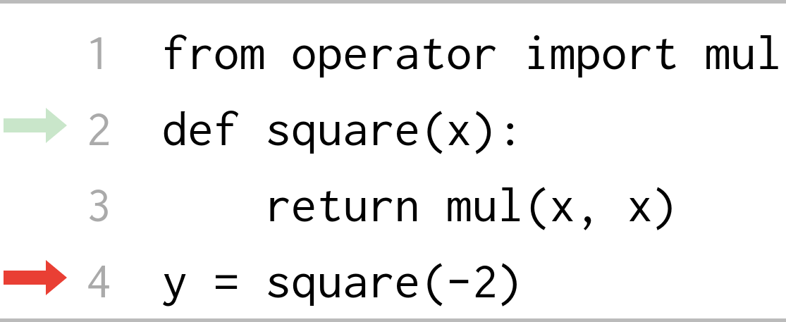
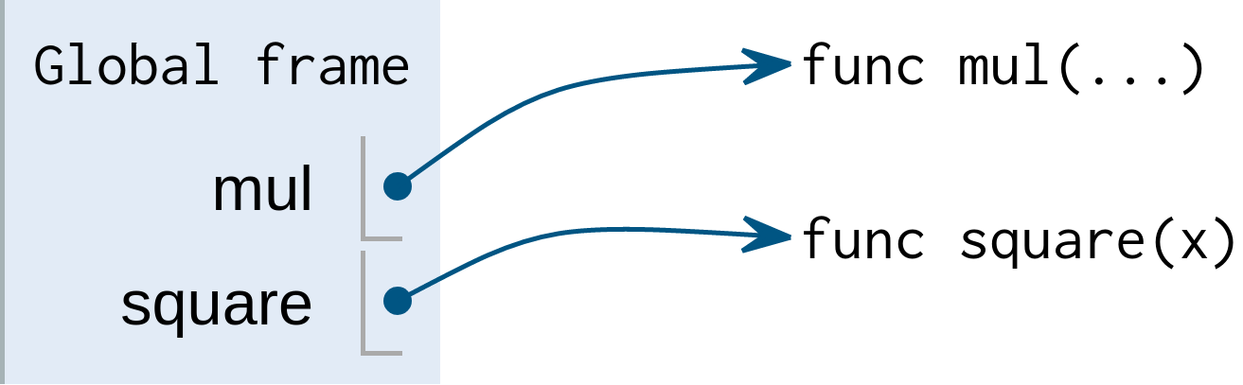
Calling user-defined functions
Procedure for calling/applying user-defined functions (version 1)
Create a new environment frame
Bind the function's parameters to its arguments in that frame
Execute the body of the function in the new environment
Built-in function
User-defined function

Slide 14
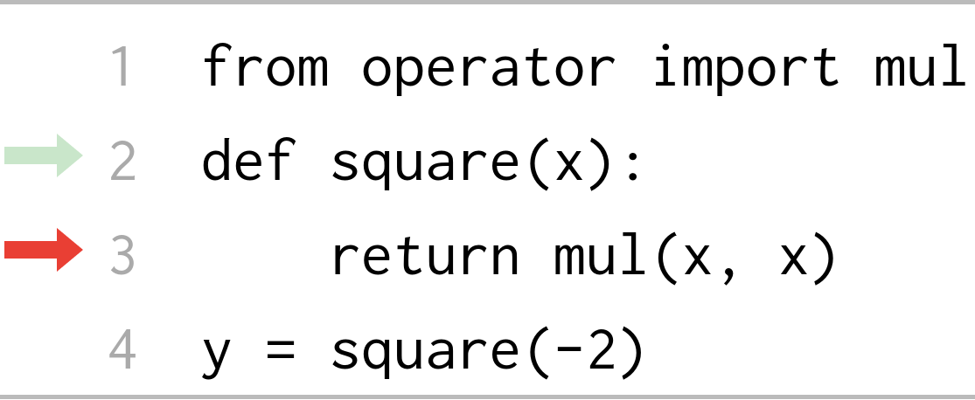
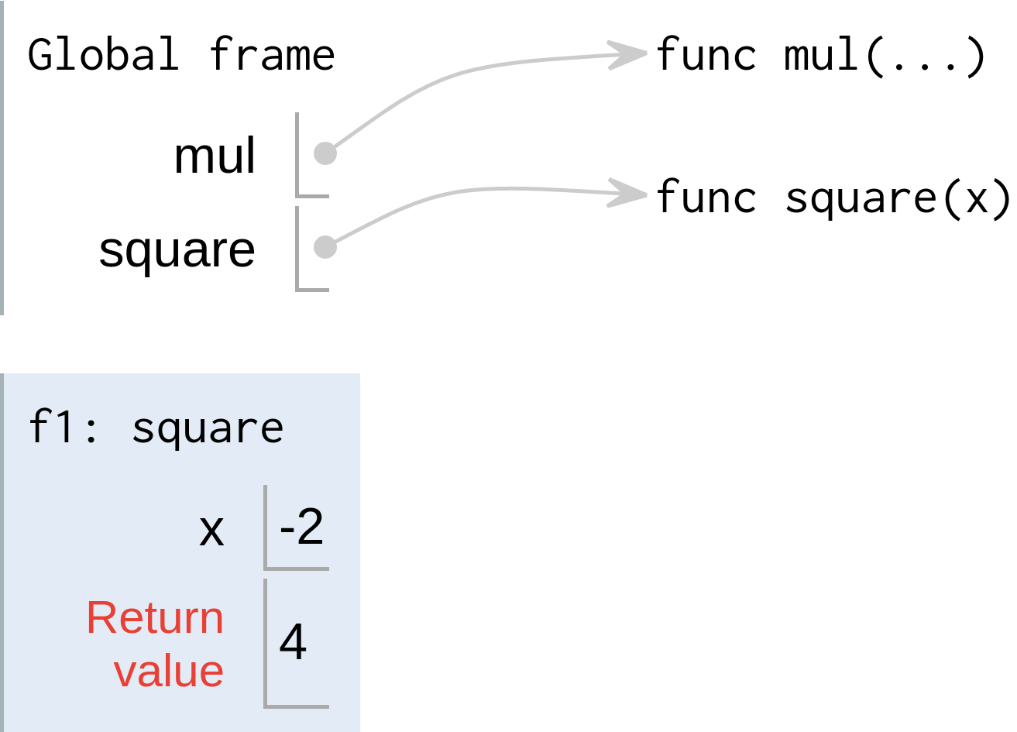
Calling user-defined functions
Procedure for calling/applying user-defined functions (version 1)
Create a new environment frame
Bind the function's parameters to its arguments in that frame
Execute the body of the function in the new environment
Built-in function
Local frame
User-defined function
Intrinsic name
A function's signature has all the information needed to create a local frame

Slide 15
Calling user-defined functions
Procedure for calling/applying user-defined functions (version 1)
Create a new environment frame
Bind the function's parameters to its arguments in that frame
Execute the body of the function in the new environment
Local frame
Formal parameter bound to argument
Intrinsic name
A function's signature has all the information needed to create a local frame

Slide 16
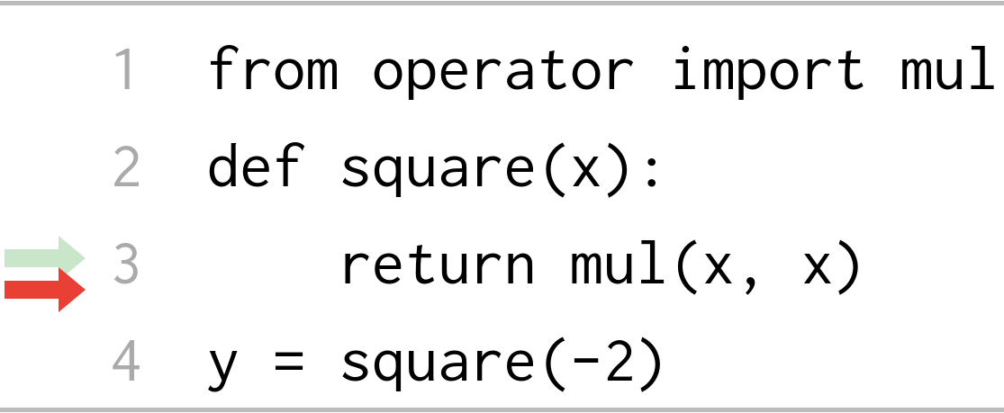
Calling user-defined functions
Procedure for calling/applying user-defined functions (version 1)
Create a new environment frame
Bind the function's parameters to its arguments in that frame
Execute the body of the function in the new environment
Formal parameter bound to argument
Return value (not a binding!)

Slide 17
Break!

Slide 18
Environments

Slide 19
Life cycle of a function
Name
A new function is created!
Name bound to that function in the current frame
def square(x): return mul(x, x)
Operator: square
Function: func square(x)
Operator & operands evaluated
Function applied to arguments
y = square(1 - 3)
Operand: 1-3
Argument: -2
Local frame
A new frame is created!
Parameters bound to arguments
Body executed in environment
Formal parameter bound to argument

Slide 20
Looking up names in environments
Every expression is evaluated in the context of an environment.
An environment is a sequence of frames
So far, there have been two possible environments:
The global frame
A function's local frame, then the global frame
Rules for looking up names in user-defined functions (version 1)
Look it up in the local frame
If name isn't in local frame, look it up in the global frame
If name isn't in either frame, NameError

Slide 21
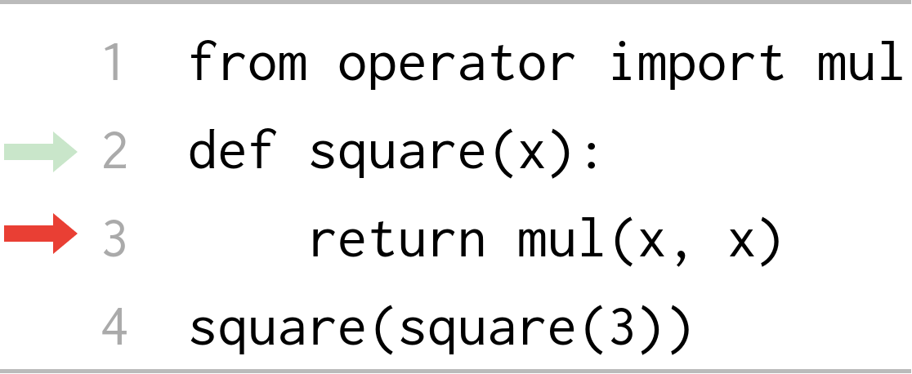
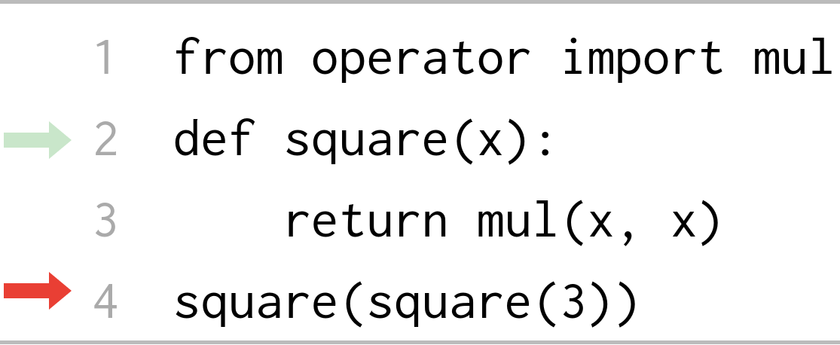
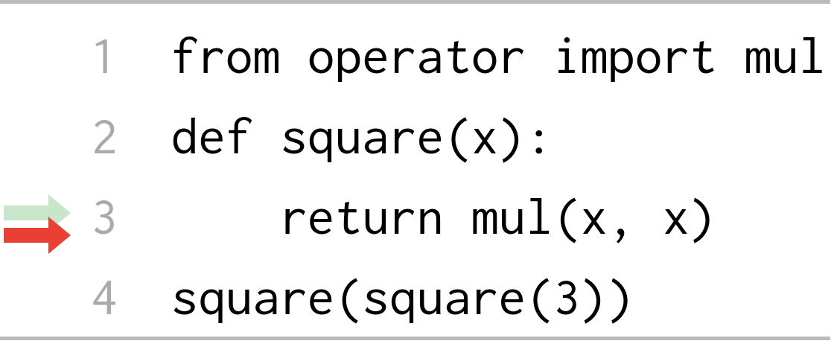
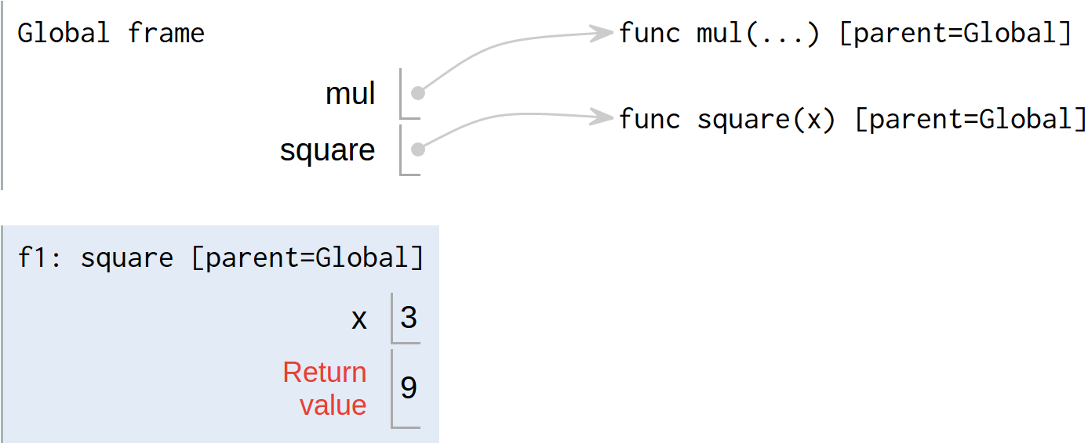
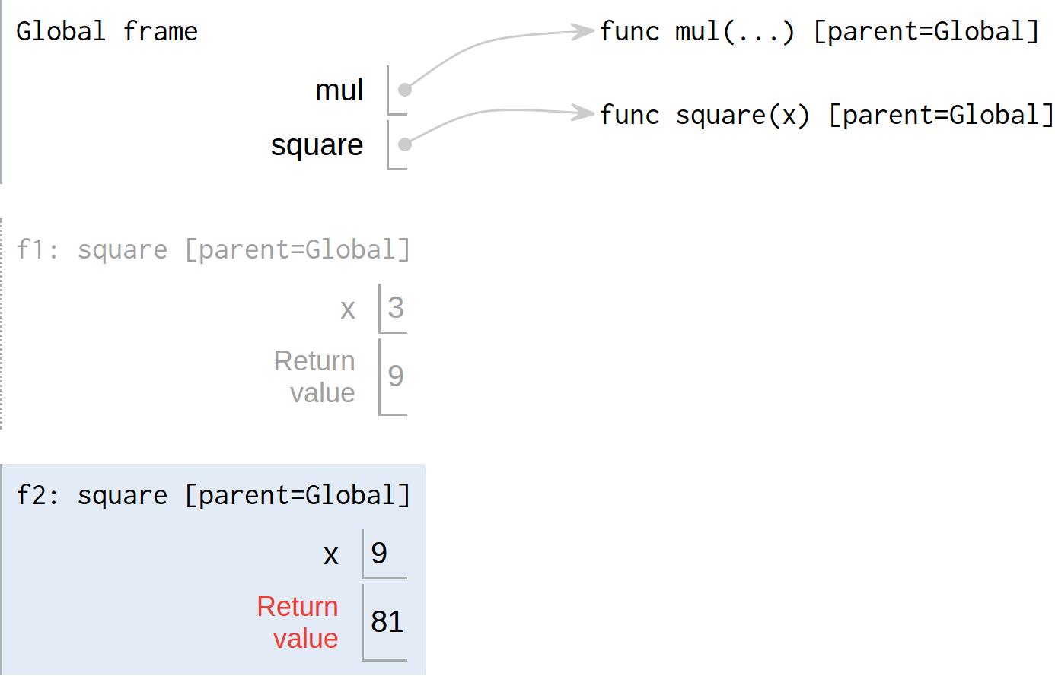
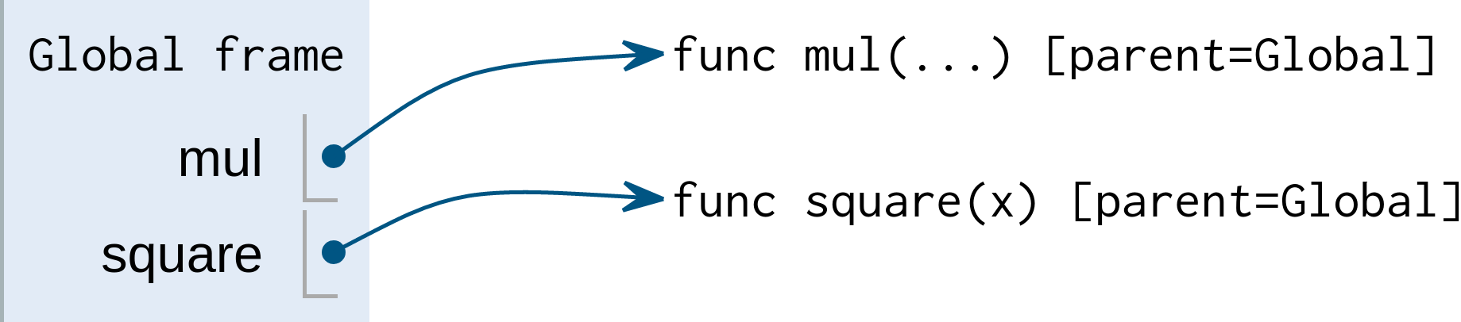
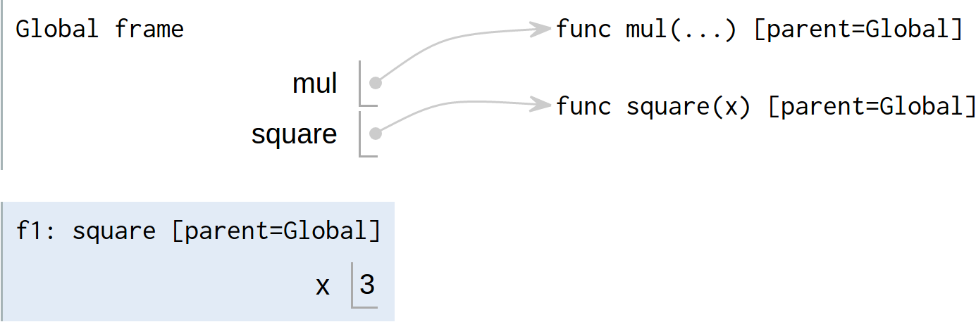
Multiple environments
Demo
1
2
1
81
square(square(3))
1
func square(x)
9
square(3)
An environment is a sequence of frames
The global frame alone
A local, then the global frame
func square(x)
3

Slide 22
Print and None

Slide 23
None means that nothing is returned
The special value None represents nothing in Python
Functions that do not explicitly return a value will return None
None is not displayed when evaluated by the interpreter
>>> def does_not_return_square(x): ... x * x ...
>>> def does_not_return_square(x): ... x * x ... >>> does_not_return_square(4)
>>> def does_not_return_square(x): ... x * x ... >>> does_not_return_square(4) >>> sixteen = does_not_return_square(4)
>>> def does_not_return_square(x): ... x * x ... >>> does_not_return_square(4) >>> sixteen = does_not_return_square(4) >>> sixteen + 4
Traceback (most recent call last):
File "<stdin>", line 1, in <module>
TypeError: unsupported operand type(s) for +: 'NoneType' and 'int'
No return!
The name sixteen is now bound to None
None is not displayed by the interpreter

Slide 24
Pure functions and non-pure functions
Pure functions just return values
Non-pure functions have side effects
pow
Return value
2, 27
2 arguments
134217728
Returns None but not displayed by interpreter
2, 27
print
None
A side effect isn't a value; it's anything that happens as a consequence of calling a function
Python displays the output: 2 27

Slide 25
Nested expressions
1
print
None
???
>>> print(print(1), print(2))
1
1
2
None None
2
print
None
2
Not displayed by interpreter
None, None
print
None
None None

Slide 26
More functions
Demo
The operands of a call expression can be any expression
What about the expression, square?
>>> four = describe(square, -2)
Calling function with argument -2
Result was 4
>>> four
4
>>> sixteen = describe(square, four)
Calling function with argument 4
Result was 16
>>> sixteen
16

